Slide 1

My Company - Calico Gateway API
Month Year
Presented by Solutions Architect

Slide 2
Recapitulative
Traffic Control & Routing
Security & Compliance
Monitoring & Debugging

Slide 3
Recapitulative
01

Slide 4
Kubernetes Native vs Ingress Gateway
Kubernetes provides three core service types for exposing apps:
ClusterIP - Internally only
NodePort - Inflexible, manual, conflictual
LoadBalancer - Costly (1 per service)
Native Kubernetes services handle L4 exposure but lack L7 flexibility, security, and portability. Ingress/Gateway API fills these gaps with standardised, feature-rich traffic management.
Each solves a piece of the puzzle, but gaps remain.
Feature | Native Kubernetes (ClusterIP/NodePort/LoadBalancer) | Ingress/Gateway API
External Access | Limited (NodePort: manual port management, LoadBalancer: cloud-specific). | Standardized L7 (HTTP/HTTPS) routing.
Traffic Routing | L4 only (no host/path rules). | Path-based (/api), host-based (app.example.com), headers, traffic splitting.
TLS Termination | Manual cert management (e.g., Service Mesh needed). | Built-in TLS termination (e.g., cert-manager integration).
API Gateway Features | None (requires third-party tools). | Rate limiting, auth (OIDC/JWT), request rewriting, retries.
Multi-Tenancy | No namespace isolation for routing. | HTTPRoute scoped to namespaces (Gateway API).
Cloud Portability | Tied to cloud LoadBalancers (AWS ALB, GCP LB). | Vendor-neutral configuration.
Security | Basic NetworkPolicy (L3/L4). | mTLS, WAF integration, L7 policies.
Observability | Limited (service metrics only). | Envoy access logs, Prometheus metrics, distributed tracing.

Slide 5
Traffic Control & Routing
02

Slide 6

Critical Gaps in Kubernetes Traffic Control
"How do you roll out new features without downtime or risk?"
What happens if the new version has a critical bug?
How can we minimize user impact during deployments?
Is there a way to automatically roll back if errors occur?
"How do we support multi-cluster and hybrid-cloud routing?"
Can we split traffic across clusters (e.g., 80% in AWS, 20% in GCP)?
How do we handle failover if a cluster goes down?
Is there geo-aware routing to direct users to the nearest region?
"How do we handle failures gracefully without manual intervention?"
What if a backend becomes unhealthy—does traffic automatically shift away?
Can we define SLA-based routing (e.g., route away if latency > 500ms)?
Is there circuit-breaking to prevent cascading failures?
"How do we monitor and troubleshoot traffic routing in real-time?"
Can we see live traffic distribution between versions?
Are there detailed metrics (success rate, latency, errors) per route?
How do we trace a request path for debugging?

Slide 7

Where Legacy Routing Falls Short
No native Kubernetes support for canary/blue-green deployments
Manual scripting or external tools required.
No fine-grained control over traffic shifting (e.g., 5% → 10% → 50%).
Hard-coded routing rules in legacy Ingress
Static configurations require redeployment for changes.
No dynamic traffic splitting based on conditions.
Lack of observability in traffic routing
Difficulty tracking which requests go to which version.
No built-in metrics for success/failure rates per backend.
Security and compliance risks
No built-in way to enforce zero-trust policies during traffic shifts.
Risk of exposing unfinished features to unintended users.

Slide 8
Traffic Routing
2.1

Slide 9

Solution: Traffic Splitting
1. Weighted Splitting
- Percentage-based distribution (e.g., 70/30)
2. Header-Based Routing
- Split based on HTTP headers (e.g., `x-user-type: premium`)
3. Path-Based Routing
- Route by URL path (e.g., `/v1/` → `v1-service`)
4. Query Parameter Routing
- Split by URL query params (e.g., `?version=beta`)
5. Cookie-Based Routing
- Direct traffic using session cookies
6. Geolocation Routing
- Route by client IP/country (e.g., EU → `europe-service`)
7. Traffic Mirroring (Shadowing)
- Copy traffic to another cluster without affecting responses
8. Canary Deployments
- Subset-based splitting (e.g., 5% to new version)
9. Runtime Fractional Routing
- Dynamic splits controlled by runtime configuration
10. Priority-Based Routing
- Route to clusters based on priority levels
11. Load Balancer Subsets
- Split traffic to endpoint subsets (e.g., by zone/version)
Each type can be combined (e.g., **weighted + header-based**) for advanced use cases.
Notes:
https://gateway.envoyproxy.io/latest/tasks/traffic/

Slide 10




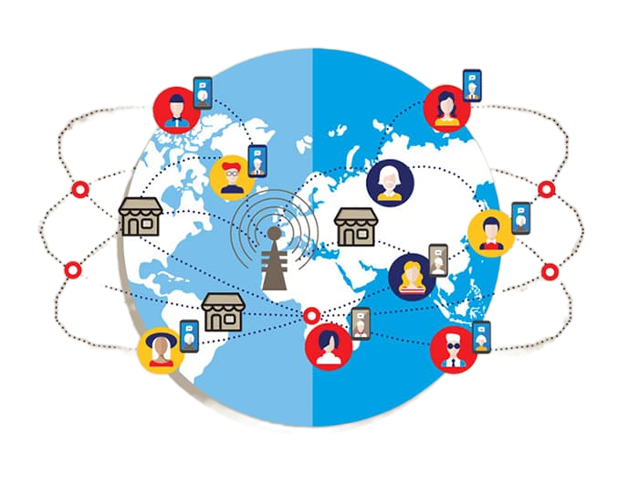

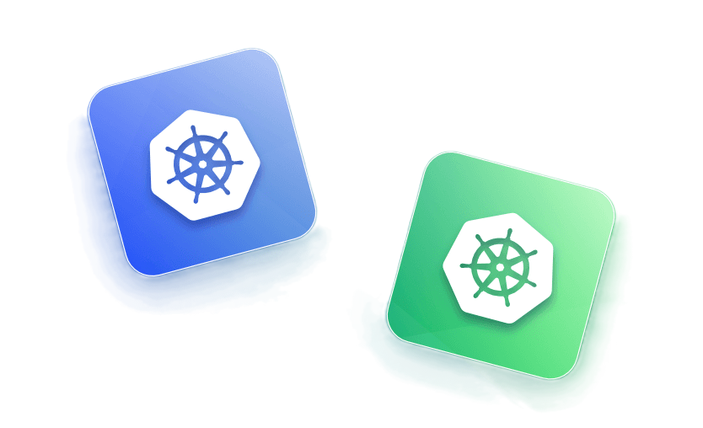

Common Deployment Strategies with Calico Gateway

Slide 11
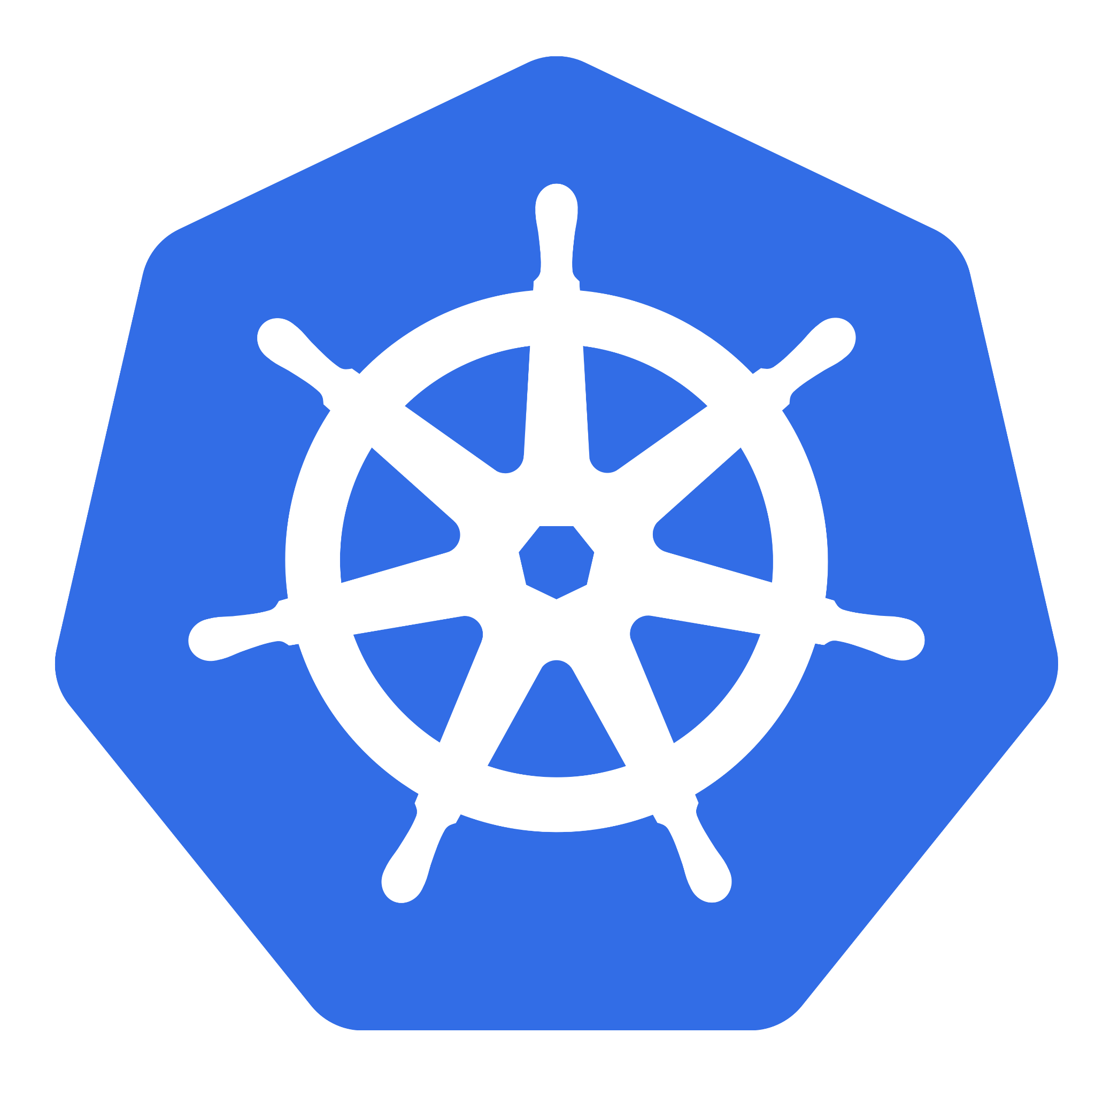






Canary Deployments
apiVersion: gateway.networking.k8s.io/v1
kind: HTTPRoute
metadata:
name: canary-demo
namespace: prodapps
spec:
parentRefs:
- name: calico-gateway
kind: Gateway
hostnames:
- "prodapps.com"
rules:
- matches:
- path:
type: PathPrefix
value: /prodapps
backendRefs:
- name: canary-service
port: 80
weight: 10
- name: primary-service
port: 80
weight: 90
Gradually roll out new versions to a subset of users
Traffic splitting based on weight 90/10
Often used for testing new features with minimal risk

Slide 12


Blue Green Deployments
apiVersion: gateway.networking.k8s.io/v1
kind: HTTPRoute
metadata:
name: blue-green-demo
namespace: prodapps
spec:
parentRefs:
- name: calico-gateway
kind: Gateway
hostnames:
- "prodapps.com"
rules:
- matches:
- path:
type: PathPrefix
value: /prodapps
backendRefs:
- name: blue-service
port: 80
weight: 100
rules:
- matches:
- path:
type: PathPrefix
value: /prodapps
backendRefs:
- name: blue-service
port: 80
weight: 100
- matches:
- path:
type: PathPrefix
value: /green-test
backendRefs:
- name: green-service
port: 80
weight: 100
Maintain two identical production environments
Switch all traffic from "blue" (old) to "green" (new) at once
Enables instant rollback if issues occur
backendRefs:
- name: green-service
port: 80
weight: 100

Slide 13


A/B Testing
‘’’’’’’’’’’’’’’’’’’’’’’’’’’’
rules:
#B group: if header "x-ab-group: B" is present
- matches:
- path:
type: PathPrefix
value: /prodapps
headers:
- name: x-ab-group
value: B
backendRefs:
- name: ab-version-b
port: 80
weight: 100
#Default group A — all other traffic
- matches:
- path:
type: PathPrefix
value: /prodapps
backendRefs:
- name: ab-version-a
port: 80
weight: 100
Route traffic based on request attributes (headers, cookies, etc.)
Useful for testing different versions with specific user segments (example: Mobile vs PC browsers)
More sophisticated than simple percentage-based split

Slide 14


Traffic Mirroring (Shadowing)
apiVersion: gateway.networking.k8s.io/v1
kind: HTTPRoute
metadata:
name: mirroring-example
namespace: default
spec:
parentRefs:
- name: calico-envoy-gateway
kind: Gateway
namespace: tigera-gateway
hostnames:
- "app.example.com"
rules:
- matches:
- path:
type: PathPrefix
value: /myapp
filters:
- type: RequestMirror
requestMirror:
backendRef:
name: shadow-service
port: 8080
group: ""
kind: Service
backendRefs:
- name: primary-service
port: 8080
Send a copy of production traffic to new version
Doesn't affect live users while testing real traffic patterns
Helps validate performance before actual cutover
Notes:
https://gateway.envoyproxy.io/latest/tasks/traffic/http-request-mirroring/

Slide 15
Header-Based Routing
# Rule 1: Green users (new features)
- matches:
- headers:
- type: Exact
name: x-user-color
value: green
filters:
- type: RequestHeaderModifier
requestHeaderModifier:
set:
- name: x-routed-color
value: green
backendRefs:
- name: green-service
port: 8080
weight: 100
# Rule 2: Yellow users (beta features)
- matches:
- headers:
- type: Exact
name: x-user-color
value: yellow
backendRefs:
- name: yellow-service
port: 8080
# Rule 3: Red users (default stable)
- backendRefs:
- name: red-service
port: 8080
Route traffic based on HTTP headers
Useful for internal testing or feature flags
Example: Route employees to new version while customers stay on stable
Notes:
The RequestHeaderModifier filter for green users serves several important purposes in this header-based routing scenario.
Request Tracking & Visibility:
Adds x-routed-color: green to clearly mark in backend logs which requests were intentionally routed to the green service
Helps distinguish between requests that should go to green vs those that accidentally ended up there
Downstream Processing:
The backend services can inspect this header to know the request was explicitly routed (not just defaulted)
Useful for analytics, debugging, or special processing of green-user requests
Consistency Enforcement:
Ensures all green requests have this marker, even if the original x-user-color header gets removed/modified during transit
Audit Trail:
Creates evidence of the routing decision that persists through the entire request chain

Slide 16
Weighted Traffic Splitting
apiVersion: gateway.networking.k8s.io/v1
kind: HTTPRoute
metadata:
name: basic-weighted-split
spec:
parentRefs:
- name: envoy-gateway
rules:
- backendRefs:
- name: service-v1
port: 80
weight: 70
- name: service-v2
port: 80
weight: 30
Distribute traffic across multiple service versions
More flexible than simple canary (can split across multiple versions)
Example: 70% v1 and 30% v2

Slide 17



Geographic Routing
apiVersion: gateway.networking.k8s.io/v1
kind: HTTPRoute
metadata:
name: geo-routing
spec:
parentRefs:
- name: envoy-gateway
rules:
- matches:
- headers:
- name: "x-geo-region"
value: "africa"
backendRefs:
- name: africa-service
port: 80
- matches:
- headers:
- name: "x-geo-region"
value: "europe"
backendRefs:
- name: europe-service
port: 80
- matches:
- headers:
- name: "x-geo-region"
value: "america"
backendRefs:
- name: america-service
port: 80
- backendRefs: # Default route
- name: default-service
port: 80
Envoy filter to add x-country-code header based on IP
Lower Latency
Regulatory Compliance
Load Distribution
Security & Access Control
Localized Experience
Smart Testing & Rollouts
Fault Isolation
Notes:
🌍 Why Route Client Traffic by Geolocation?
⚡ Lower Latency: Route users to the nearest region/data center for faster response times.
🌐 Regulatory Compliance: Ensure traffic stays within specific regions (e.g., GDPR, data residency laws).
📈 Load Distribution: Balance traffic across geographically distributed services to avoid hotspots.
🔒 Security & Access Control: Restrict or shape access based on region (e.g., block high-risk countries).
🗣️ Localized Experience: Deliver region-specific content (language, offers, UI) for better user engagement.
🧪 Smart Testing & Rollouts: Gradually roll out new versions or features to specific regions.
🚨 Fault Isolation: Route around outages by steering traffic away from affected regions.

Slide 18


GRPC Routing
/rides.BookingService/RequestRide
hostnames:
- "api.rideshare.com"
rules:
- matches:
- method:
service: "rides.BookingService"
method: "RequestRide"
backendRefs:
- name: booking-service
port: 50051
weight: 100 # 100% to booking-service
- matches:
- method:
service: "rides.TrackingService"
method: "StreamLocation"
backendRefs:
- name: tracking-service
port: 50052
weight: 100 # 100% to tracking-service
svc.Frontend
svc.booking
/rides. TrackingService/StreamLocation
svc.tracking
Your mobile app sends gRPC requests directly to Envoy Gateway.
Envoy routes each method to the right microservice (no frontend involved).
Result: Faster, more efficient, and scalable than traditional REST-through-frontend approaches.
gRPC also supports all the previous http deployments we have covered and many more.
Notes:
1. Core Diagram Flow
Mobile App like UBER → Envoy Gateway:
Phone sends gRPC calls (e.g., RequestRide, StreamLocation) over HTTP/2.
Binary Protobuf = Smaller payloads vs. JSON (5-10x faster serialization).
Envoy’s Smart Routing:
Routes /package.Service/Method paths directly to microservices:
RequestRide → booking-service
StreamLocation → tracking-service
No frontend involvement = Fewer hops, lower latency.
2. Why gRPC + Envoy?
Performance:
HTTP/2 multiplexing allows 100s of streams over 1 TCP connection.
Critical for real-time features (e.g., driver location updates).
Resilience:
Envoy handles gRPC-specific failures (UNAVAILABLE, DEADLINE_EXCEEDED) with retries/circuit breaking.
Traffic Control:
Canary deployments: Shift traffic between gRPC server versions (e.g., booking-v1 → booking-v2).
3. Business Impact
User Experience:
Faster ride bookings/live tracking (200ms lower latency vs. REST).
Cost Efficiency:
Fewer servers needed (HTTP/2 reduces connection overhead).
Scalability:
Envoy load balances gRPC streams evenly, even with persistent connections.

Slide 19
Traffic Shaping
2.2

Slide 20
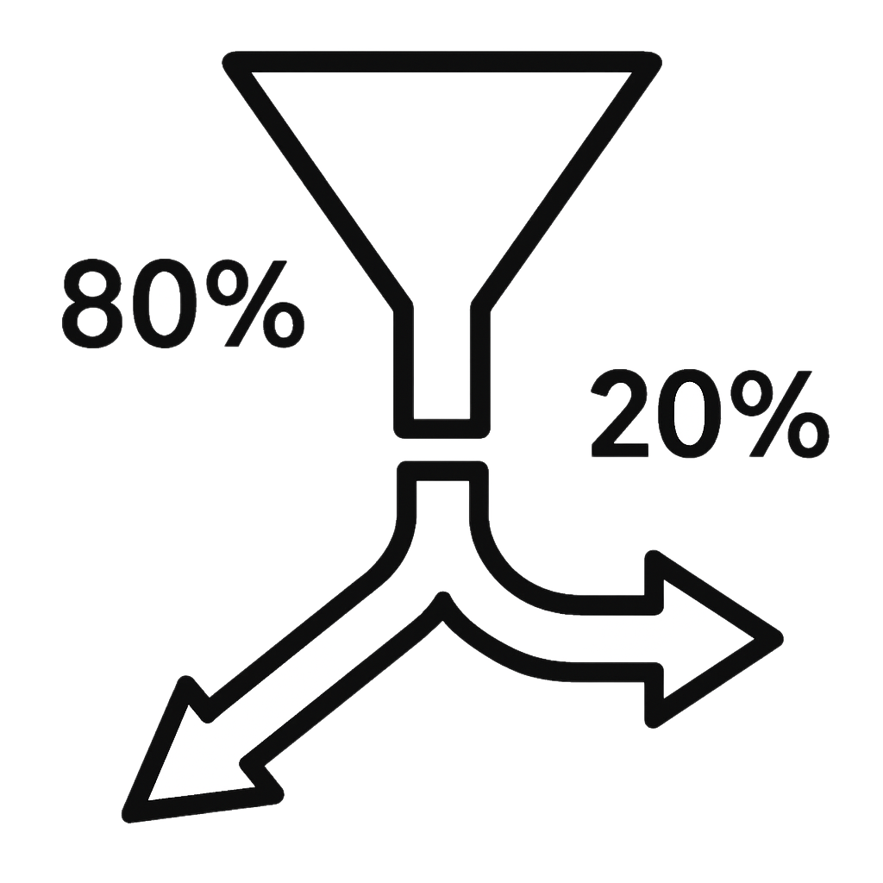
Traffic Shaping
Rate Limiting
Global (external service) and local (in-process) request throttling.
Supports requests per second (RPS) or connection limits.
Circuit Breaking
Automatically blocks traffic to overwhelmed services (based on errors/timeouts).
Configurable thresholds for max connections, pending requests, etc.
Retry Policies
Controls retry attempts for failed requests (with backoff strategies).
Can filter retries based on status codes/gRPC codes.
Timeouts
Sets deadlines for requests (global, per-route, or per-cluster).
Load Shedding
Drops or queues requests when upstream services are overloaded.
Request Buffering
Delays or buffers requests (e.g., for streaming or batch processing).
Bandwidth Limits
Throttles bandwidth for HTTP/TCP streams (bytes per second).
Fault Injection
Simulates failures (aborts/delays) to test resilience.
Priority-Based Routing
Directs traffic to high/low-priority clusters based on load.
Adaptive Concurrency
Dynamically adjusts request limits based on latency metrics.
Quota Management
Enforces usage quotas (e.g., API calls/user).
Notes:
https://gateway.envoyproxy.io/latest/tasks/traffic/
Prevent service overload
Improve reliability during spikes
Enforce fair usage policies
Test failure scenarios

Slide 21
Local Rate Limiting
Cluster
App
10 req/sec
Calico Ingress Gateway
App 2
App 3

Slide 22
Global Rate Limiting
Cluster
App
Calico Ingress Gateway
10 req/sec
App 2
App 3

Slide 23

Circuit Breaking
Cluster
App
Calico Ingress Gateway
App 2
App 3

Slide 24
Other Traffic Functions
2.3

Slide 25
Coming Soon - WAF
Cluster
WAF
X
App 1
Calico Ingress Gateway
App 2
App 3

Slide 26
Advanced Load Balancing - Consistent Hash
Cluster
Sticky Session
HTTP Headers
App
Calico Ingress Gateway
App
App

Slide 27
Direct Response
Cluster
HTTP Request
App
Calico Ingress Gateway
App 2
App 3

Slide 28
And lots and lots more…
Circuit Breaker
Backend Routing
Client Traffic Policy
Connection Limit
Direct Response
Failover
Fault Injection
GRPC Routing
HTTP Redirects
HTTP Request Headers
HTTP Response Headers
HTTP Timeouts
HTTP URL Rewrite
HTTP Request Mirroring
Multicluster Service Routing
Response Compression
Response Override
Retry
Accelerated TLS Handshakes
API Key Authentication
Backend Mutual TLS: Gateway to Backend
Backend TLS: Gateway to Backend
Basic Authentication
CORS
External Authorization
IP Allowlist/Denylist
JWT Authentication
JWT Claim-Based Authorization
Mutual TLS: External Clients to the Gateway
OIDC Authentication
Threat Model
TLS Passthrough
TLS Termination for TCP

Slide 29
Security & Compliance
03

Slide 30
Monitoring & Debugging
04

Slide 31
Thank you

